Slide 1
Progress report 26/09
Anh Tuan Cao

Slide 2
Overview
Bearing ring Dataset (continue)
Open relay Dataset
Continual learning in predictive maintenance
Water surface detection
Question and Answer from last meeting
Dynamic output expansion

Slide 3
1. Bearing ring dataset (Continue)
Bearing Damage
ISO 15243 is an international standard that provides a systematic methodology for classifying and understanding different types of bearing damage. They categorizes bearing damage into six main damage modes, each with its own subcategories that provide further specificity about the nature and causes of the damage.
Fatigue: occurs due to repeated stress or load cycles over time, leading to the eventual weakening and breakdown of the bearing material.
Wear: is caused by the continuous rubbing or sliding of bearing components against each other (metal-to-metal contact) or when hard particles (such as dust or dirt) enter the bearing and grind away material from the surfaces.
Corrosion: Corrosion damage results from chemical reactions between the bearing material and environmental elements such as moisture, water, or aggressive chemicals.
Electrical Erosion: Electrical erosion occurs when electric currents pass through the bearing, causing localized melting and pitting of the bearing surfaces.
Plastic Deformation: Plastic deformation occurs when the bearing material is permanently deformed due to excessive load, improper installation, or impact.
Fracture and Cracking: Fracture and cracking occur when a bearing experiences excessive stress or shock, causing the material to break or crack.

Slide 4
1. Bearing ring dataset (Continue)
Bearing Damage Description
Damage combination in rolling bearings describes the different patterns of damage that can occur on a bearing. Rather than focusing on a single instance of damage, this criterion classifies damage based on how widespread or repetitive the symptoms of damage are across the bearing.
Single damage: a single component of the rolling bearing is affected by only one specific type of damage.
Example: a single pitting on the inner ring.
Repetitive damage: same type of damage appears multiple times at different locations on the same bearing component.
Example: non-continuous pittings on the inner ring raceway.
Multiple Damage: different types of damage occur on the same bearing, or the same type of damage occurs on multiple bearing components.
Example: pitting on the inner ring combined with wear on the outer ring or both cracks on both inner and outer ring.

Slide 5
1. Bearing ring dataset (Continue)
Bearing Damage Description
The Arrangement of the repetitive and multiple damages criterion focuses on how damage symptoms are distributed or arranged on different components of the bearing. It is divided into three options: regular, random, and no repetition.
Regular: The damage symptoms occur in a consistent, predictable, and repeating pattern on the bearing component.
Example: a series of pits or wear marks are spaced evenly along the inner ring of the bearing.
Random: The damage symptoms appear at random, with no apparent pattern or regular spacing across the component.
Example: several pits or cracks appear on the inner ring, but they are scattered randomly.
No Repetition: The damage occurs only once on the component, meaning there is no repeated or widespread damage across the surface.
Example: A single localized instance of damage, such as one pit, crack, or deformation.

Slide 6
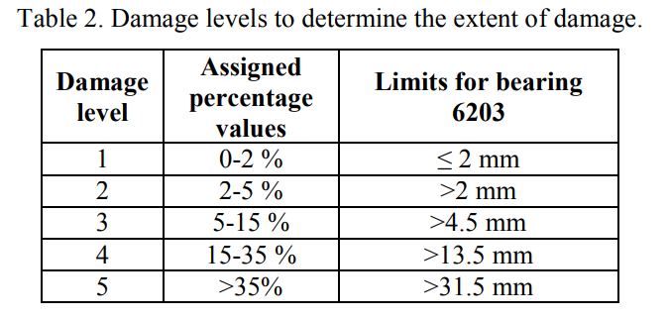
1. Bearing ring dataset (Continue)
Bearing Damage Description
The extent of damage criterion refers to how large or severe the damage is on a bearing, with this size being expressed in normalized levels. These levels are designed to be independent of the size of the bearing itself, making it easier to compare damage across different bearings.

Slide 7
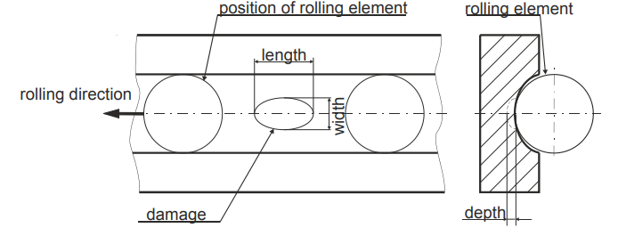
1. Bearing ring dataset (Continue)
Bearing Damage Description
The characteristic of damage criterion is used to categorize bearing damage into two main groups: single point damage and distributed damage.
Single Point Damage: Refers to damage that is localized to a specific, small area on the bearing surface. The defining feature is that the damage is small enough that only one rolling element (such as a ball or roller) comes into contact with the damage at any given time.
Distributed Damage: This type of damage is more spread out over a larger area of the bearing, affecting multiple rolling elements as they pass over the damaged section.

Slide 8
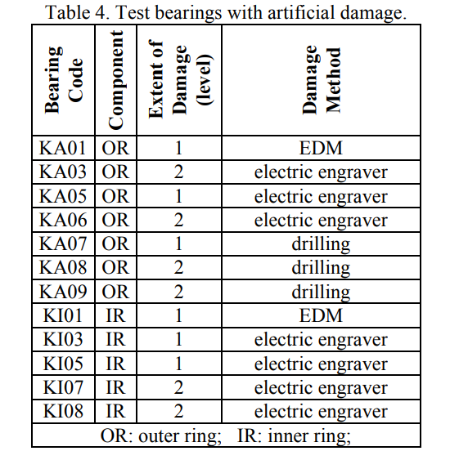
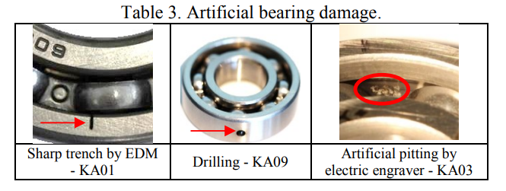
1. Bearing ring dataset (Continue)
Bearing Damage: artificial damage
Bearing Damage is generated either by artificial or real damages.
The artificial damages used in this paper were caused by three different methods: electric discharge machining, drilling, manual electric engraving.
all the artificial damages are single point damages without a repetition or combination with other damages.

Slide 9
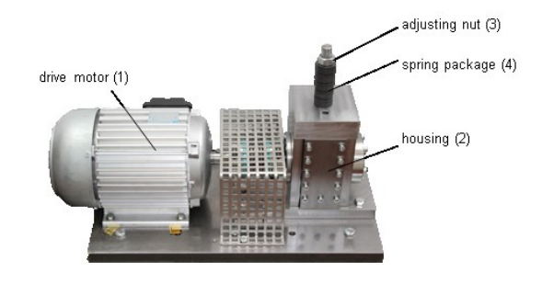
1. Bearing ring dataset (Continue)
Bearing Damage: real damage
There are two options to test and develop CM methods with measurement data of real bearing damages: to measure bearing damages in real or in scientific test rigs.
But in real production environmental bearing has long lifetime and if damage is recognized, bearings are replaced before failure, Therefore, often only a small number of damage states are available.
For better data generation: ball bearings with real damages were obtained from an accelerated life time test.
The bearings are tested under a radial load applied via a spring-screw mechanism. (allows for precise control of the force)
The radial force is higher than usual, to accelerate fatigue damage, but controlled to prevent exceeding the bearing's static load capacity.
Low viscosity oil is used to create poor lubrication conditions, which increases friction and wear, further promoting damage to the bearings.
This setup is intended to study how bearings fail under harsh conditions and to simulate real-world situations where lubrication might be inadequate.

Slide 10
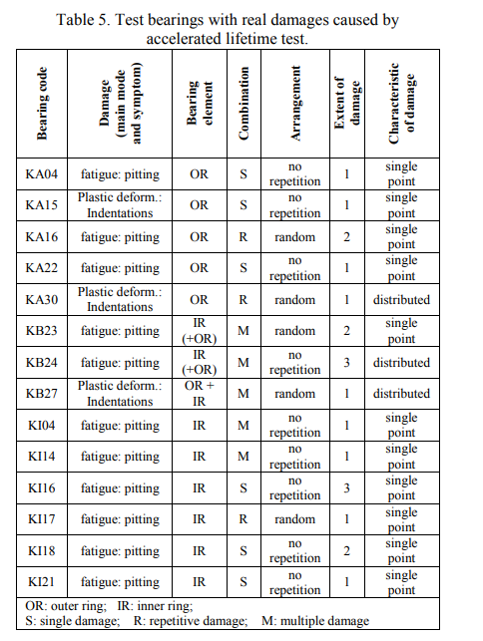
1. Bearing ring dataset (Continue)
Bearing Damage
108 bearings were subjected to a lifetime test to assess their durability and how they fail over time under operational conditions.
Out of these 108 bearings, 18 bearings were found to have damage, and 33 individual damages were recognized across these 18 bearings.
Fatigue is the most common form of damage, accounting for around 70% of all observed cases.
The rest of the damages, except for one fracture, were due to plastic deformation.
no damage was found on the rolling elements

Slide 11
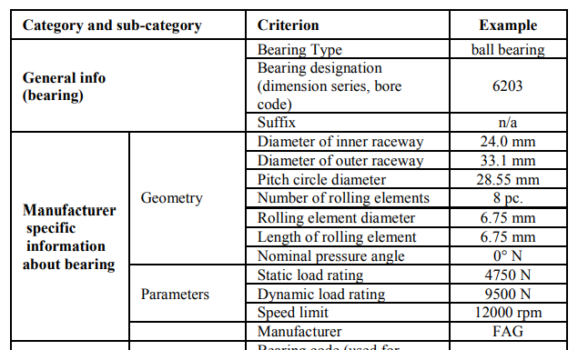
1. Bearing ring dataset (Continue)
Bearing Dataset – Uni Paderborn
One bearing ring model is used in this experiment

Slide 12
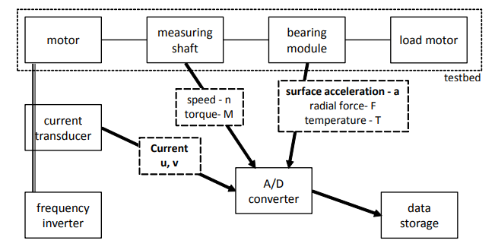
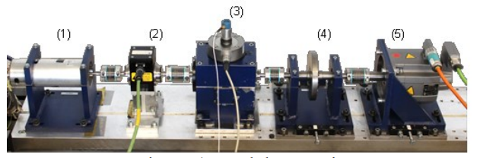
1. Bearing ring dataset (Continue)
Bearing Dataset – experiment test rig
The test rig consists of several modules: an electric motor (1), a torque-measurement shaft (2), a rolling bearing test module (3), a flywheel (4) and a load motor (5).
The motor phase currents are measured by a current transducer, then filtered by a 25 kHz low-pass filter and converted from an analogue to a digital signal with a sampling rate of 64 kHz.
The acceleration of the bearing housing is measured using a piezoelectric accelerometer and a charge amplifier with a low-pass filter at 30 kHz. The signal is digitalized and saved synchronously to the MCS with a sampling rate of 64 kHz
additional parameters are measured synchronously to the motor currents and vibration signal but with lower sampling rates: radial force, load torque, rotational speed and the oil temperature in the bearing module.

Slide 13
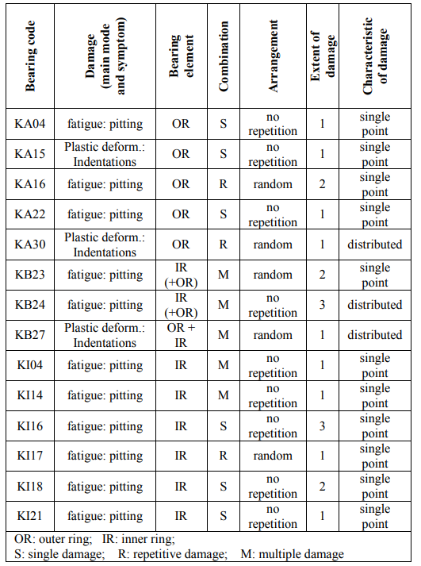
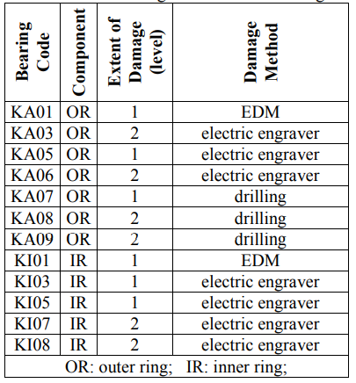
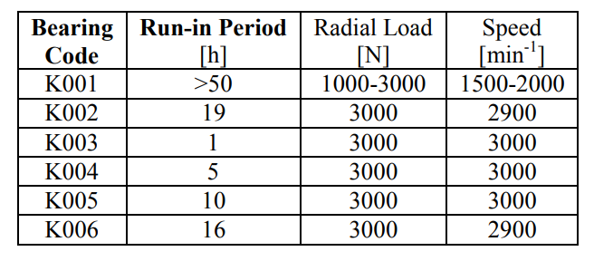
1. Bearing ring dataset (Continue)
Bearing Dataset – Summary
The data consists of measurements from 32 different bearing experiments.
Undamaged (healthy) bearings (6x)
Artificially damaged bearings (12x)
Bearings with real damages caused by accelerated lifetime tests, (14x)

Slide 14
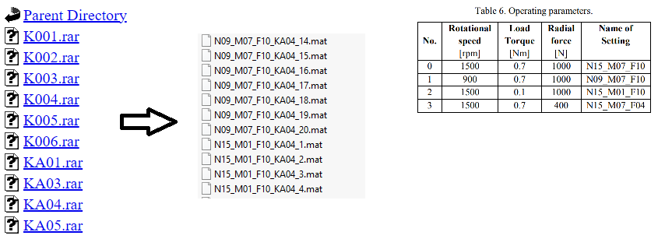
1. Bearing ring dataset (Continue)
Bearing data
The dataset is divided into multiple files with experiment on a bearing ring with bearing damage code.
20 measurements of 4 seconds each for each setting, saved as a matlab file with a name consisting of the code of the operating condition and the four-digit bearing code (e.g. N15_M07_F10_KA01_1.mat).

Slide 15
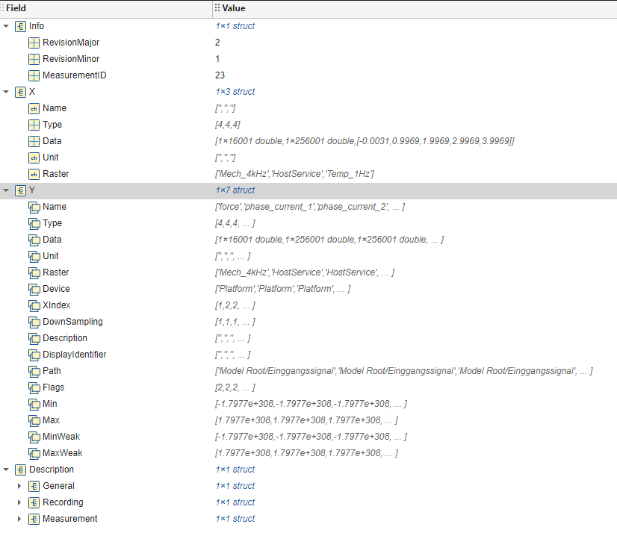
1. Bearing ring dataset (Continue)
Bearing data
Each mat file contain information of a measurement.
For example: IDs, timestamp, duration, personal, etc..

Slide 16
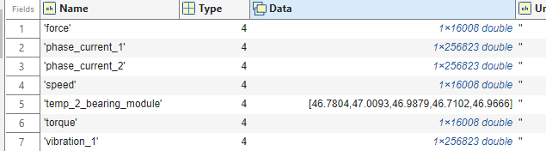
1. Bearing ring dataset (Continue)
Bearing data
We are only interested in Y field
Measuring time is 4s
It contain:
Operating parameter with sampling rate of 4 KHz.
Two motor current signal with sampling rate of 64 KHz.
Vibration Signals with sampling rate of 64 KHz.

Slide 17
1. Bearing ring dataset (Continue)
Motor Current Signal and Vibration Signal
Motor Current Signal: The motor current signal is the electrical current that is drawn by the motor from the power supply, and it directly reflects the motor’s operation.
Advantages:
Can be monitored remotely without requiring direct access to the bearing or motor.
Cost-effective compared to vibration sensors as it uses existing electrical signals.
Limitations:
Less sensitive than vibration analysis.
Vibration Signal: Vibration signals are physical signals captured using accelerometers or other vibration sensors placed directly on the bearing housing or nearby structures. These signals measure the mechanical vibrations caused by the bearings.
Advantages:
High sensitivity to bearing defects, especially in the early stages of damage.
Provides detailed information about the nature and severity of the fault.
Can detect a wide range of faults, including misalignment, imbalance, and looseness, in addition to bearing issues.
Limitations:
Requires direct sensor placement, which may not always be feasible.
Sensors can be costly, and installation requires careful positioning for accurate measurements.

Slide 18
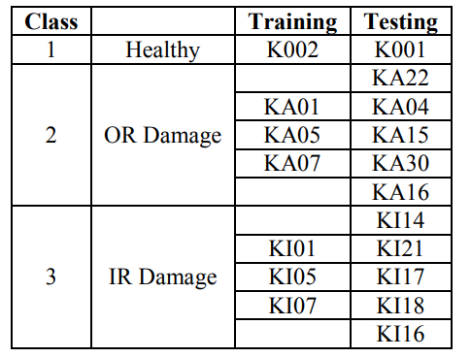
1. Bearing ring dataset (Continue)
Damage classification
Data preprocessing: extract frequency feature with (FFT and PSD) -> Feature extraction: 23 distinct Feature
Feature: 9 out of 23 features are selected from each of the two MCS per sample and 15 features from the vibration signals.
Then separate data into test and training data

Slide 19
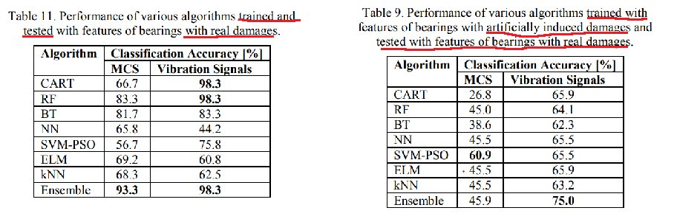
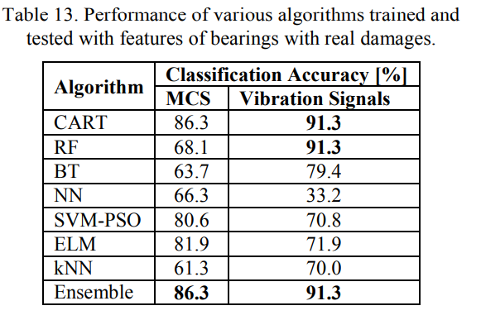
1. Bearing ring dataset (Continue)
Damage classification
Different machine learning methods are used on different scenario (single damage only vs with multiple damage)

Slide 20
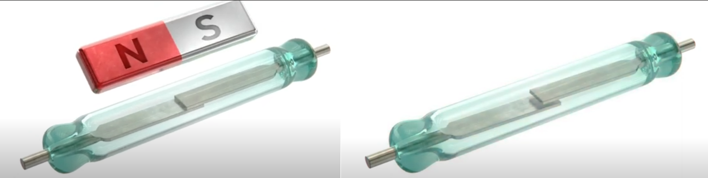
2. Open relay dataset
Relay basic operation:
Relays use an electromagnetic coil to control the movement of internal contacts. When a control signal is applied to the coil, it generates a magnetic field that either closes or opens the relay’s contacts, depending on the relay type.
This mechanism allows a low-power control signal to operate a high-power circuit, providing electrical isolation between the control and the load.
A (Normally) Open relay is a type of relay in which the default state of the relay contacts is open, meaning that no current flows through the circuit when the relay is not energized.

Slide 21
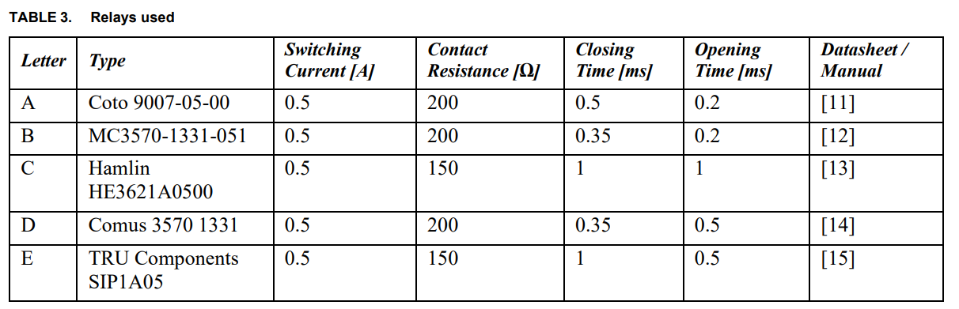
2. Open relay dataset
Relays used in dataset:
All of the relays used in this dataset are normally open reed relay with different characteristics

Slide 22
2. Open relay dataset
Relay characteristics
Switching Current: Switching current is the maximum current that a relay can handle through its contacts during the switching operation without damaging or degrading the contact surfaces.
Contact Resistance: Contact resistance is the resistance across the closed contacts of the relay when it is in the ON state. This resistance consists of the inherent resistance of the contact material and any resistance introduced by contact wear or contamination. High contact resistance can lead to voltage drops, signal distortion, or heat generation.
Closing Time (Operate Time): Closing time, or operate time, is the time taken for the relay contacts to close after the coil is energized.
Opening Time (Release Time): Opening time, or release time, is the time taken for the relay contacts to open after the coil is de-energized.

Slide 23
2. Open relay dataset
Relay Degradation
Switching Operation and Arc Formation:
During the switching process, there is a brief period when the contacts are close but not fully connected.
In this state, the air gap between the contact tongues becomes very small, allowing a voltage flashover to occur. This flashover creates a small electrical arc.
Effects of Arcing on Contacts:
The arc that forms during switching is a high-energy event that causes localized heating and physical erosion of the contact surfaces.
Over time, the repeated formation of arcs degrades the contact surfaces, altering their condition and increasing the contact resistance. This degradation is progressive and can lead to significant wear.

Slide 24
2. Open relay dataset
Relay Degradation impact
Switching Current: As relays degrade, the switching current capability can be reduced due to the wear and erosion of the contact surfaces.
Contact Resistance: Contact resistance increases as the relay ages due to surface wear, oxidation, and the buildup of contaminants.
Closing Time (Operate Time): The closing time of a relay can become longer as the relay's components wear out.
Opening Time (Release Time): Similar to closing time, the opening time may also become extended.

Slide 25
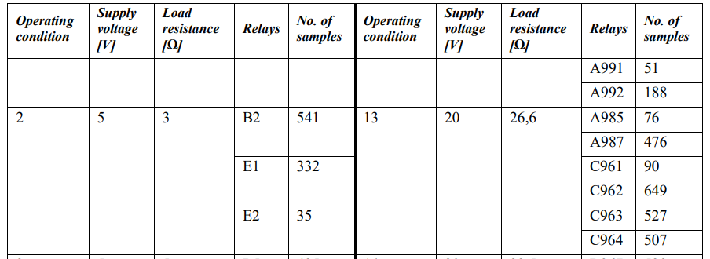
2. Open relay dataset
Relay Degradation data collection
Using the test bench, 100 relays were opened and closed alternately under 22 different operating conditions defined via the supply voltage and the load resistance.
2 different operating conditions defined via the supply voltage and the load resistance (see Table 4) until failure. For every 50th cycle, the voltage curve during opening and closing of the load circuit of the respective relay as well as the contact resistance were measured.
For each relay, the corresponding metadata, i.e. in particular the number of cycles until failure, the supply voltage and the load resistance, were also stored.

Slide 26
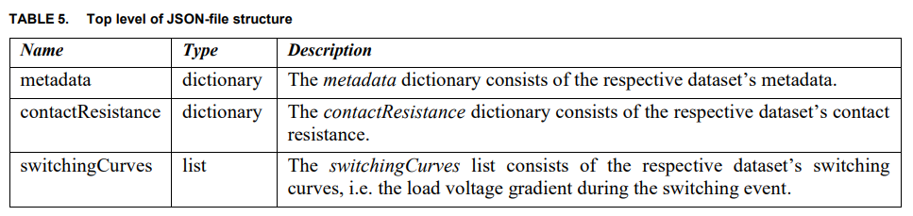
2. Open relay dataset
Relay Degradation data collection
Data is for each types of relay is stored in a Json file.
We are interested in contact resistance and switching curves.

Slide 27
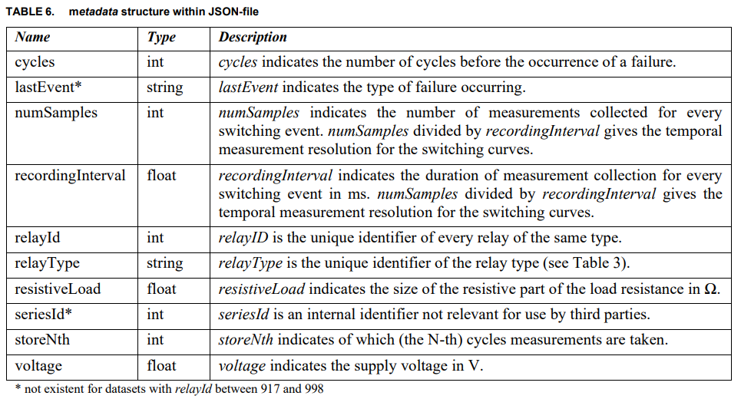
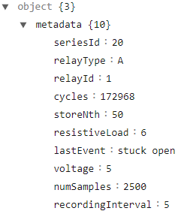
2. Open relay dataset
Metadata structure
Cycles: each cycles consist of 2 event: close and open.
Recording Interval is 5μs for the switching curves.

Slide 28
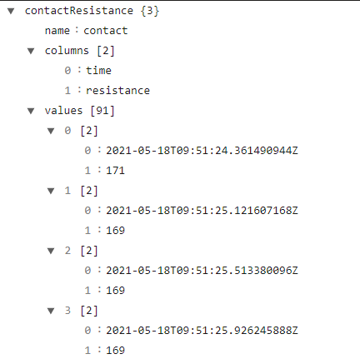
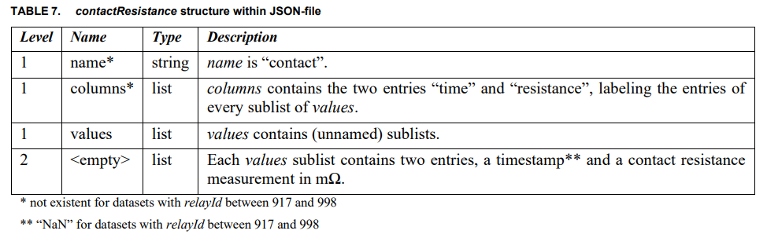
2. Open relay dataset
Contact resistance structure
The contact resistance measurements that are included correspond to the time period where switching curves were collected.
For example in A1 data is record starting in closing event at cycle 65051 timestamp 09:51:30.511507176Z and end at opening event at cycle 65101 timestamp 09:52:50.16548796Z.
Then contact resistance measuring should start and ends around that time (from 09:51:24.361490944Z to 09:53:00.723117056Z), measuring interval is unknown.

Slide 29
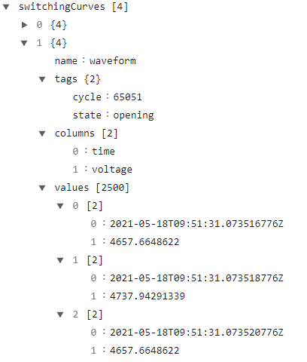
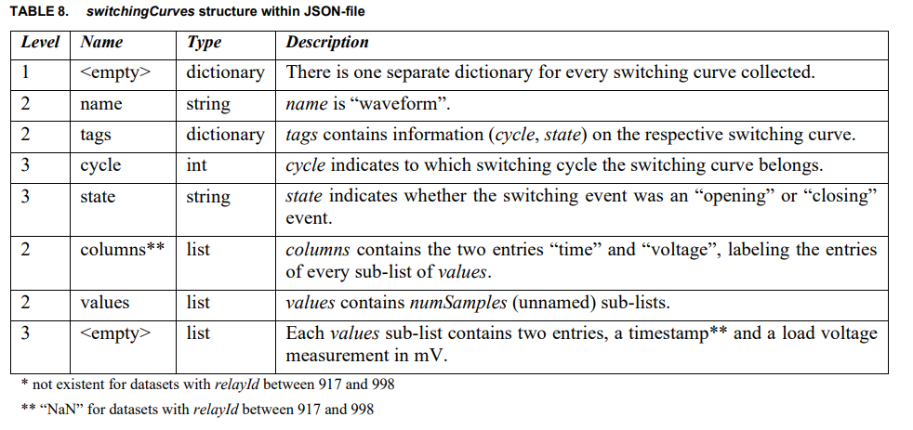
2. Open relay dataset
Switching curves structure

Slide 30
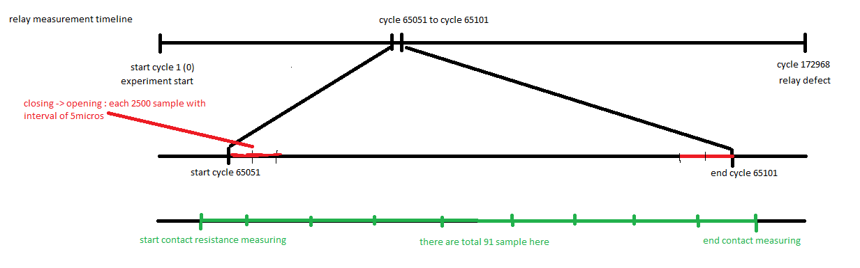
2. Open relay dataset
Measurement timeline overview
Not all of cycle are recorded, only random interval of time in the life cycle is recorded.
Contact resistance and switching curves data is not aligned in time.

Slide 31
3. Continual learning in predictive maintenance
Problem formulation
Continual learning scenario is task or domain incremental learning base on the parameters.
The problem is now regression (classification is also possible).
Each task consisted of data with known failure.

Slide 32
3. Continual learning in predictive maintenance
Example: HDD dataset: overview
One task now include one or more samples.
For each model we select the model that it's failure day is known.
In real life scenario, we keep collecting the data every day, until 1 drive is defect, then compose the data into 1 sample. Then feeds these samples into the models for continual learning.
With this model we can have an use case:
A program that detects HDD has 30 days till failure.
A program that detects sudden decrease of days till failure of a HDD

Slide 33
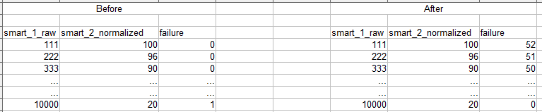
3. Continual learning in predictive maintenance
Example: HDD dataset: data transformation
Supposed that we only interested in smart_1_raw and smart_2_normalized
Chose data of a HDD, which is defected, an gather its data from a specifics N days
We can also transform HDD models name or HDD specific stats into number as input to change problem into tasks incremental learning.
For labeling: example if we limit N = 40 we can label every failure > 40 to 40.

Slide 34
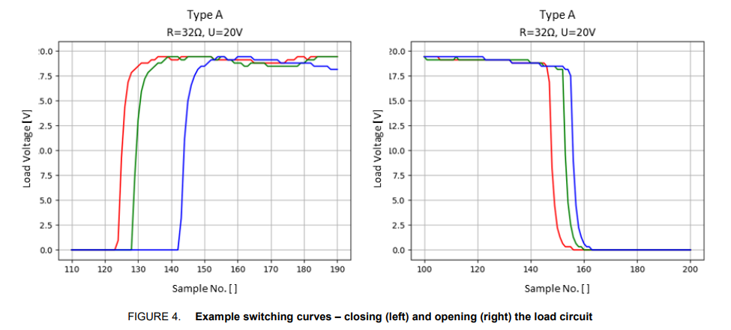
3. Continual learning in predictive maintenance
Example: Open relay dataset
Same logic can be applied to open relay dataset.
Each sample can be each relay (we can also remove relay types to make problem become domain incremental learning)
For each data row in one sample we can label by cycles remaining: last cycle – current cycle
For input parameter: open_timestamp_(1), close_timestamp_(1), contact_resistance (corresponding)

Slide 35
4. Wafer surface defect detection
Semiconductor production process
Early Detection: Identifying defects early in the manufacturing process helps prevent defective products from moving further down the production line, saving costs associated with further processing, assembly, and packaging.
Feedback for Process Improvement: Classification data provides valuable feedback to the manufacturing process, helping engineers identify and correct process issues that cause defects.
Maximizing Usable Products: Classifying defects helps in segregating wafers that are still usable for specific applications, thereby improving the overall yield.
Targeted Repairs: For certain defect types, corrective measures can be taken to repair the wafer, salvaging what would otherwise be a complete loss.

Slide 36
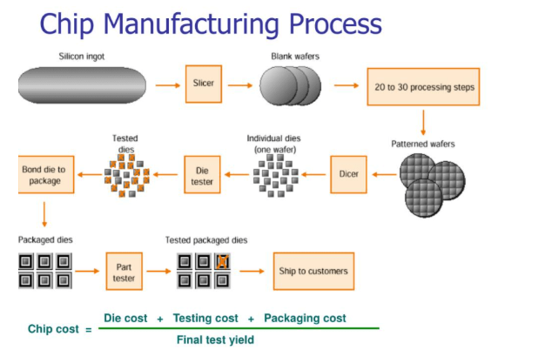
4. Wafer surface defect detection
Why wafer failure detection is needed:
Silicon Wafer Production: Production of the Wafer disk.
Wafer Fabrication: building the microscopic structures of transistors, capacitors, and other components on the wafer surface.
Wafer Testing and Dicing: Electrical tests are performed on each chip (die) on the wafer to check functionality before packaging. Then the wafer is cut into individual dies using precision saws or lasers.
Packaging, Assembly and shipping : component attachment and further testing.

Slide 37
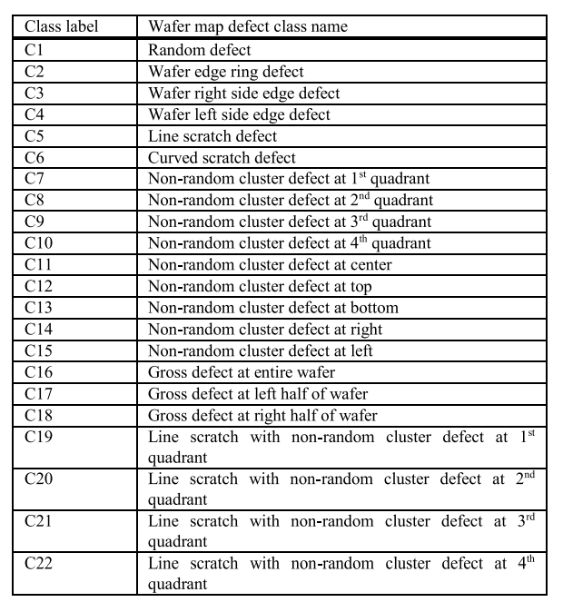
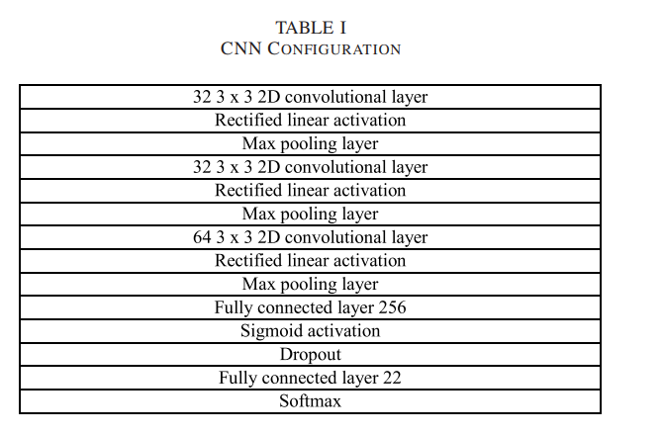
4. Wafer surface defect detection
Related paper
Wafer Map Defect Pattern Classification and Image Retrieval Using Convolutional Neural Network.
Dataset: generation using either pure random defect pattern, or random and non-random mixed pattern. Then label:
The input wafer map image size is 286 x 400.
Model is CNN

Slide 38
4. Wafer surface defect detection
Continual learning scenario
Class incremental learning can be applied in here.
For each task we can include more defect patterns.
But it does not make much sense in practice. Because most of defect pattern is already discovered and total number of pattern is also limited.

Slide 39
5. Question and Answer from last meeting
HDD life span calculation for each vendor:
What is maximum deformation
Histogram and correlation of SMART attribute example

Slide 40
5. Question and Answer from last meeting
HDD life span calculation for each vendor:
What is maximum deformation
Histogram and correlation of SMART attribute example

Slide 41
5. Question and Answer from last meeting
HDD life span calculation for each vendor:
What is maximum deformation
Histogram and correlation of SMART attribute example

Slide 42
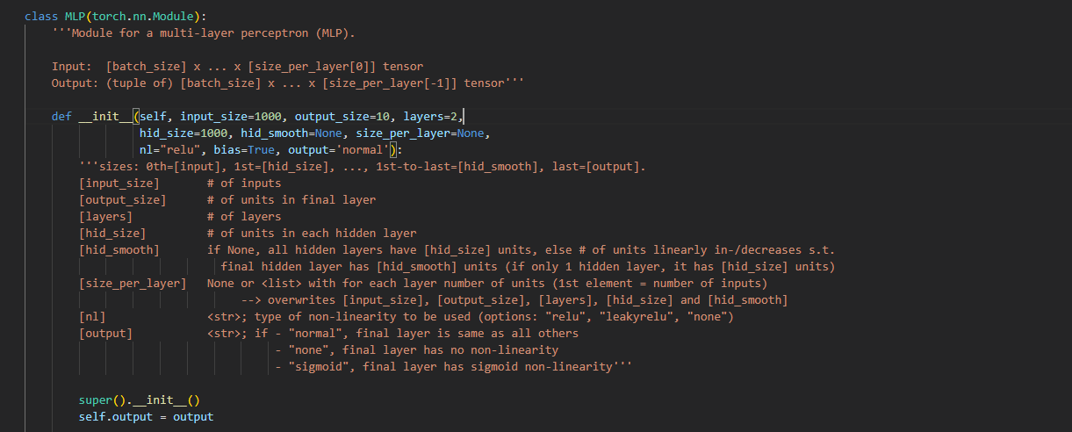
6. Dynamic output expansion
Example code
It is not mention in 'Three types of incremental learning' codes

Slide 43
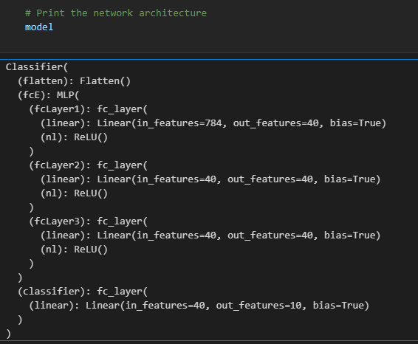
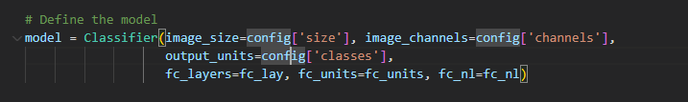
6. Dynamic output expansion
Example code
It is not mention in 'Three types of incremental learning' codes

Slide 44
6. Dynamic output expansion
Keyword for theme search
Keyword:
Dynamic Output Expansion
Class-Incremental Learning with Expanding Class Space
Open-ended deep learning model
No results matches the problem
Class incremental learning survey: https://arxiv.org/pdf/2302.03648
Incremental learning survey: https://arxiv.org/pdf/2302.00487
Both did not mention this problem.

Slide 45
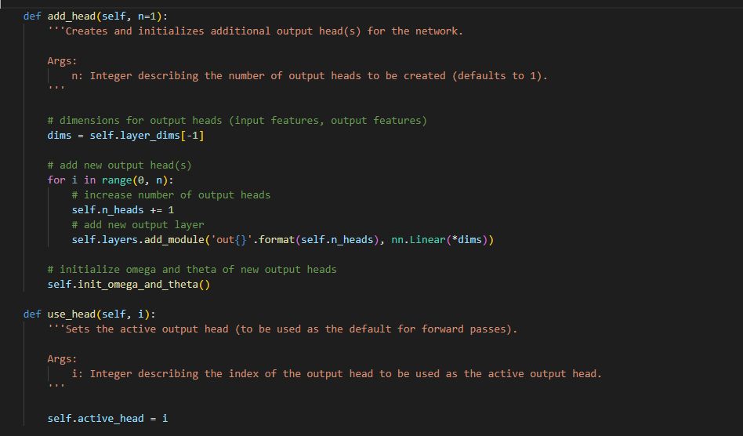
6. Dynamic output expansion
More example code
Code is taken from paper: Continual learning of neural networks for quality prediction in production using memory aware synapses and weight transfer.

